Slide 1
Time, Attendance and Leave Town Hall Updates and Reminders
Kevin Fitzgerald
Lyndi Zavy
Notes:
Opening and introductions by Kevin.

Slide 2
Agenda
Review the Time, Attendance and Leave (TAL) project
Reiterate important information
Discuss updates since first round of Town Halls
Understand the resources and support available to assist employees through transition

Slide 3
Major Impacts
All OUHSC and OUHSC-based Tulsa employees transition to biweekly pay May 31, 2015
TAL system will be used for
Hourly employees to track hours worked
Tracking leave taken and balances for all employees
Leave requests and timesheets for all employees

Slide 4
Reasons for TAL Implementation
1. Monthly payroll is challenging for administration, recruitment
2. Affordable Care Act (ACA) changes require tracking part-time employee hours in real-time
3. State of OK moved to biweekly January 2013
Notes:
The three primary drivers for the system are:
As we just discussed, there are numerous challenges to our current system and a change is long-overdue.
The Affordable Care Act dictates that we provide part-time employees with insurance benefits at a cost commensurate with actual hours worked, meaning we must track actual hours worked. Failure to do so will result in a fine per employee employed at the University. This means that if we fail to provide the appropriate level of insurance coverage to part-time employees, the University would be fined up to $22million. We have asked business units to stand up shadow systems to track hours in the absence of an institution-wide system. The TAL system will allow units to track hours worked for the ACA and for payroll purposes.
All state agencies are required to have a biweekly payroll except Higher Education. This exemption will be removed in the future, but we haven’t been given a date for the exemption expiration. We want to be ahead of the game and have a system in place so that we aren’t surprised with a tight, unattainable timeline to implement a system.

Slide 5
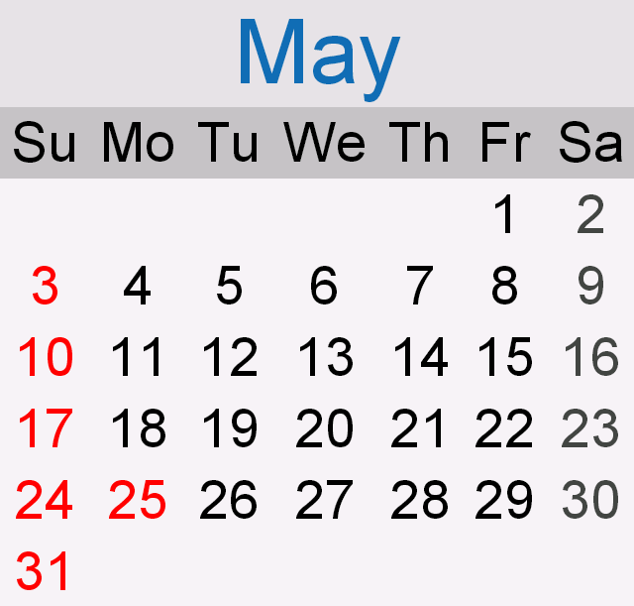
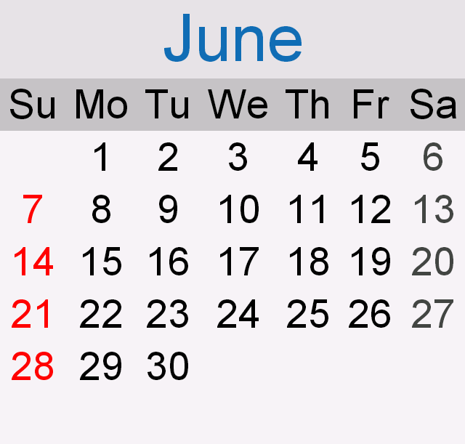
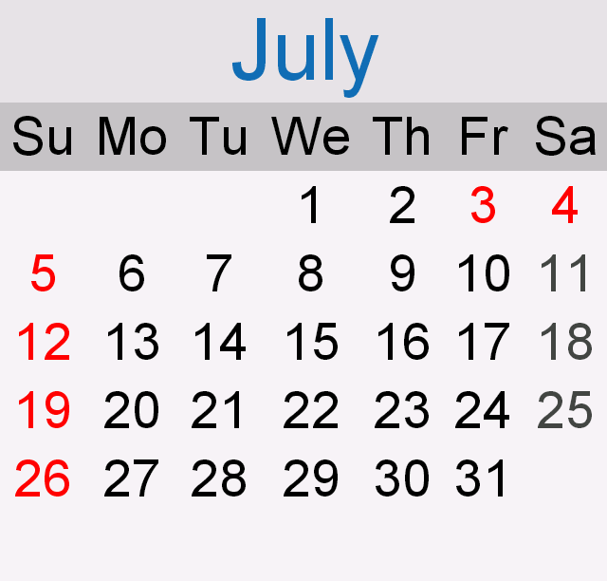
Transition to Biweekly Pay
The last monthly paycheck will be May 29, 2015
The first biweekly paycheck will be June 26, 2015
Pay day will be every other Friday, PPP remains mid-month
Employees can convert leave into funds to bridge the gap
Up to 80 hours of leave (including comp time for hourly employees), and up to 40 hours of which can be Extended Sick Leave (Sick Leave for Residents)
12
2 3 4 5 6 7

Slide 6
Leave Conversion Updates
Paid out on June 12, 2015
Leave conversion is proportional to FTE
e.g., .50 FTE employees can convert up to 40 hours of leave, of which 20 hours can be ESL
9/12 and 10/12 faculty can only convert up to 40 hours of ESL
University provided 3 days of Administrative Leave at holidays
Save this PTO for the conversion!

Slide 7
Leave Conversion Updates
Employees will complete forms to select leave conversion
Form will be sent February 2nd, due no later than May 4th
Will include supervisor name to configure TAL
All leave balances must be accurate
Payroll Coordinators can designate funding sources
Grant-funded employees can convert leave
Can be funded from grant unless specifically prohibited
Residents should contact GME office with questions
Graduate students should contact Graduate College.

Slide 8
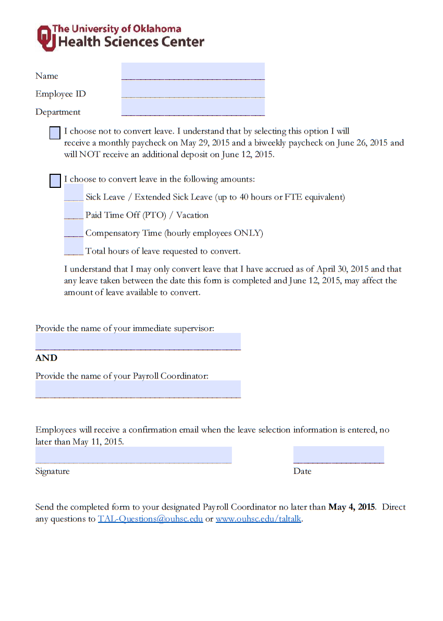
Leave Conversion Updates

Slide 9
New Hires in 2015
Important to prepare new hires for transition to biweekly pay
Discuss at interview and throughout hiring process
Anyone hired after January will not accrue 80 hours of leave to cover the conversion
Encourage new hires to save as much leave as possible
Updated offer letter wording
Lag between hire paperwork and ability to use web clock

Slide 10
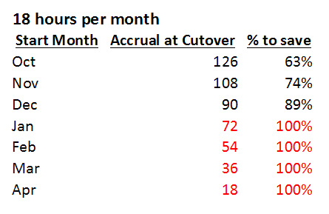
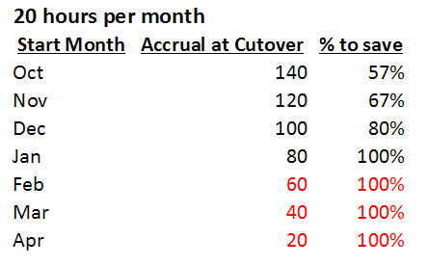
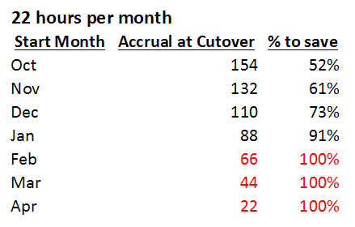
New Hires in 2015

Slide 11
PTO Accrual
Monthly Accrual | Annual Accrual | 1.0 FTE Biweekly Accrual
18 hours | 216 hours | 8.307692
20 hours | 240 hours | 9.230769
22 hours | 264 hours | 10.153846
Maximum of 336 hours remains the same

Slide 12
PTO Accrual: Update
PTO will be accrued in proportion to hours paid
Example 1, LWOP:
Employee accrues 8.307692 hours of PTO (equivalent to 18 hours/month now)
Has 20 hours of leave without pay (LWOP) in a pay cycle
Would accrue 6.230769 hours (75%) of their PTO for the pay cycle
Example 2, .80 FTE:
Accrues 80% of PTO (6.646153 hours)
PTO does not accrue while on LWOP or Extended Sick Leave (ESL)

Slide 13
Biweekly Deduction Update
24 Deductions Per Year | 26 Deductions Per Year
Medical | All Retirement Deductions
Dental | FSA Health
Vision | FSA Dependent Care
Employee/Spouse Long Term Care | Long Term Disability
Life/Supplemental Life / Dependent Life | Payroll Deductions set by employee such as United Way, Campus Campaign
Employee/Dependent AD&D | Garnishment/tax levy
Parking | Child support/spousal support
Health Club | Student Loan Deductions

Slide 14
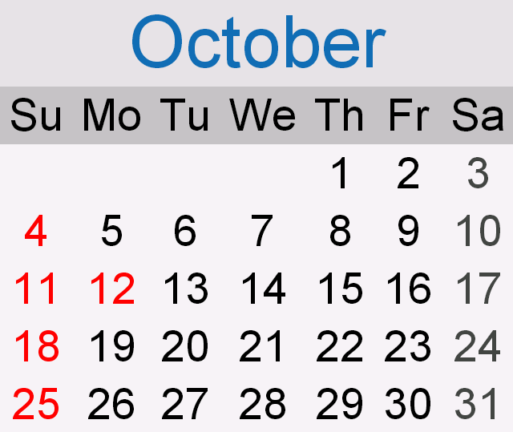
Biweekly Deduction Reminder
Typically, months with 3 pay periods will not have deductions listed as 24 deductions/year deducted
3rd check in October 2015 WILL have premium deductions to avoid deductions from 80 hour conversion
First ‘benefits premium holiday’ will be April 2016
Other deductions (listed as 26 deductions/year) come out of every check
Includes garnishments, child support, etc.

Slide 15
Biweekly Deduction Update
Athletic ticket deductions will move to the biweekly schedule
Form will be changed accordingly
April | May | June | July | August
1 monthly | 1 monthly | 1 biweekly | 2 biweekly | 1 biweekly
$250 | $250 | $125 | $125 (twice) | $125

Slide 16
Biweekly Deduction Reminder
Check your W4
Extra withholdings based on pay cycle
Example: $100 on W4 is currently $100/month, would become $100 every two weeks
Review withholdings in Self Service
Make changes to withholdings after May 2015 payroll
Notes:
If employees have additional withholdings on their W4, they will need to make changes immediately prior to the go-live (not sooner). This is because withholdings are calculated per pay period, so right now withholdings of $100 are taken every month but after the May 29, 2015 check, it would be $100 every two weeks.
PeopleSoft will automatically not take a premium deduction from the 3rd check when 3 payroll checks occur in a single month. The first time this happens is October 2015. Premium deductions must come out of the 3rd check in October 2015 in order to pay vendors on time. This was done to avoid having a premium deduction taken out of the PTO conversion. The next time there are 3 pay periods in a month is April 2016. There will be no premium deduction from the 3rd check in April, and every month thereafter with 3 pay periods will not have a these premiums deducted. This is commonly referred to as a ‘premium holiday’.
24 deductions:
Medical
Dental
Vision
Employee LTC (Long Term Care)
Spouse LTC (Long Term Care)
Life
Supplemental Life
AD/D ( Accidental Death and Dismemberment)
Dependent AD/D
Dependent Life
Spouse ADD W
Spouse Life W
26 Deductions:
All retirement deductions FSA Health ( Flexible Spending Account)
FSA Dependent Care (Flexible Spending Account)
LTD (Long Term Disability)
Other deductions include: Parking, Payroll deductions set by employee, United Way OKC/Tulsa, Campus Campaign, University Health Club, Chapter 13 Bankruptcy deductions, Child Support deductions, Spousal Support deductions, Tax Levy deductions, Student Loans deductions, and Garnishments. Athletic Tickets are different: Deduction for season ticket (football) purchase(s), total is divided by 4 months (April-July) 1 month overlap (July-October) for basketball season ticket purchase(s)

Slide 17
Resources and Support
Employee Assistance Program
http://healthysooners.ouhsc.edu/
800-327-2513
Magellan provides legal and financial support for OKC and Tulsa
Benefits-eligible employees can call up to 3 times/year
Notes:
We are partnering with our employee assistance provider to provide financial counseling to employees to help lessen the impact of the change. The 80-hour leave conversion is also a benefit for employees to help with the transition. We have a website, TAL TALK, that is available for employees (note that it is still in the early stages of development!) and employees can check into this periodically for updates. Our goal is to provide employees with regular communication: email, meetings, posters, answers to questions, etc. throughout the process. Lastly, we are partnering with financial institutions to give employees a resource should they need to take out a loan if they are unable to save PTO or funds to allow for the conversion.
Getting 40 hours of ESL is a nice option since most people never see any benefit from ESL.

Slide 18
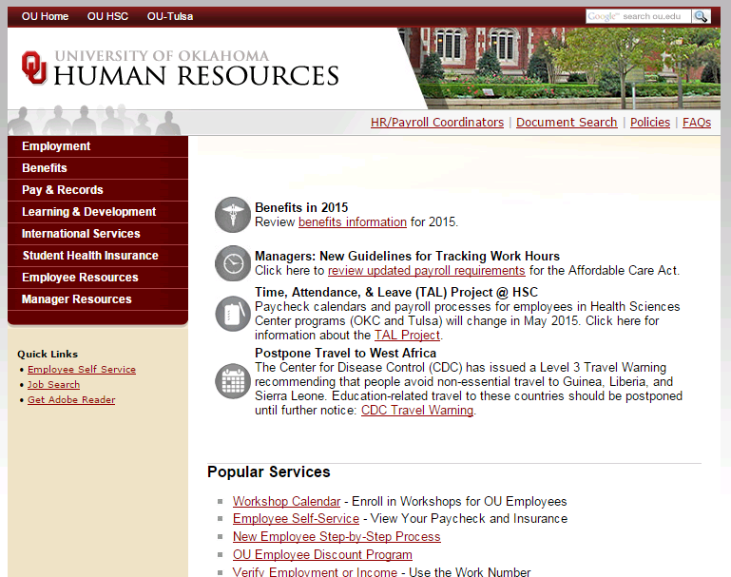
Resources and Support
Consumer Credit Counseling Services (CCCS) providing financial workshops starting in January
Take Control of Your Money
Enroll on training calendar online
Employee discounts
http://hr.ou.edu/edp
http://Magellanassist.com

Slide 19
Resources and Support
Consider talking with a credit union or bank regarding your loans
View and print the letter to creditors available on http://www.ouhsc.edu/taltalk

Slide 20
Leave Updates
New workweek Sunday-Saturday
No negative leave
Employees will select ‘leave taken’ on leave requests
System will cascade leave
Banked holiday
Comp time
PTO
Extended Sick Leave
Leave without Pay
Notes:
The system will no longer allow leave to go into the negative. It will also dictate how leave is taken (cascading leave). The system will automatically look at the employee’s balance on all types of leave and deduct accordingly. ESL will be a manual process for manager/Payroll Coordinator, since ESL is for a qualifying event and 5 days PTO first.

Slide 21
Leave Updates
One Holiday schedule
Working holidays:
Employees earn straight time for working and bank the holiday
Leave accrual and deduction are delayed 2 weeks
Some accrual and deduction for 2015 occurs in 2016

Slide 22
Overtime Updates
Hourly employees will be paid OT for working over 40 hours Sunday-Saturday
Unless compensatory time has been elected
Leave and holidays do not count as time worked for purposes of overtime calculation
Effective January 1, 2015

Slide 23
Comp Time Updates
Any remaining comp time will be paid out in May 2015 to zero out balances prior to TAL go live
No comp time allowed in May
Must be paid as overtime
Going forward, employee paid out one year after comp time accrual
System will use comp time via cascading leave

Slide 24
Job Changes in 2015
Effective date for employment status changes are set as first day of the pay cycle
Status at end of pay period applies to the whole pay period
Especially important for changes between salaried and hourly, and temp / permanent
Does not impact new hires

Slide 25
TAL System
tal.ouhsc.edu site for TAL
Link for hourly
Web clock, leave requests, balances and timesheets
Restricted to campus network
Link for salaried
Leave requests, balances, timesheets
Manager/Payroll Coordinator admin
Not restricted to network
FAQ, training, resource materials

Slide 26
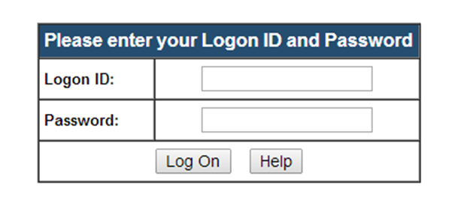
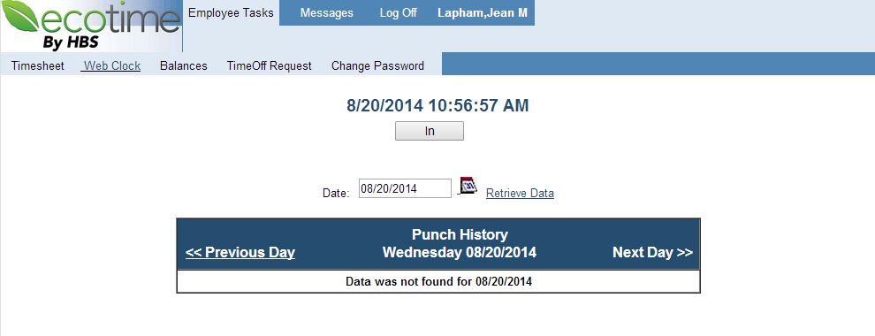
TAL System
Notes:
Direct questions to TAL-Questions@Ouhsc.edu, a mailbox that will be monitored by TAL Project Team members to ensure that questions are answered by subject matter experts in a timely manner.

Slide 27
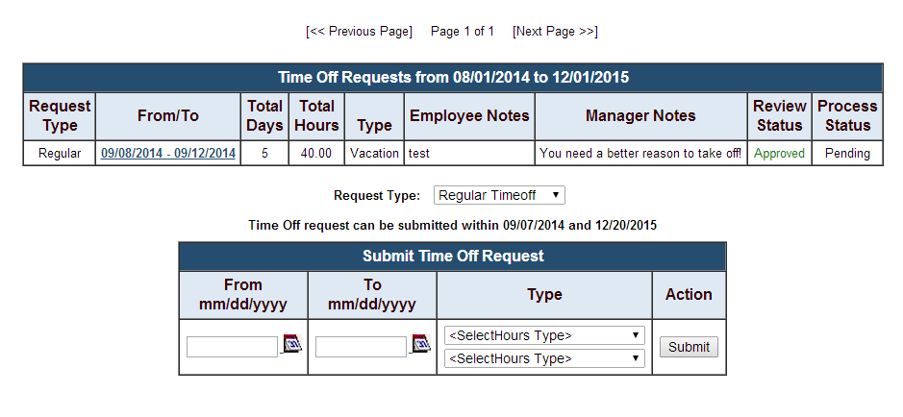
TAL System
<Leave>
Notes:
Direct questions to TAL-Questions@Ouhsc.edu, a mailbox that will be monitored by TAL Project Team members to ensure that questions are answered by subject matter experts in a timely manner.

Slide 28
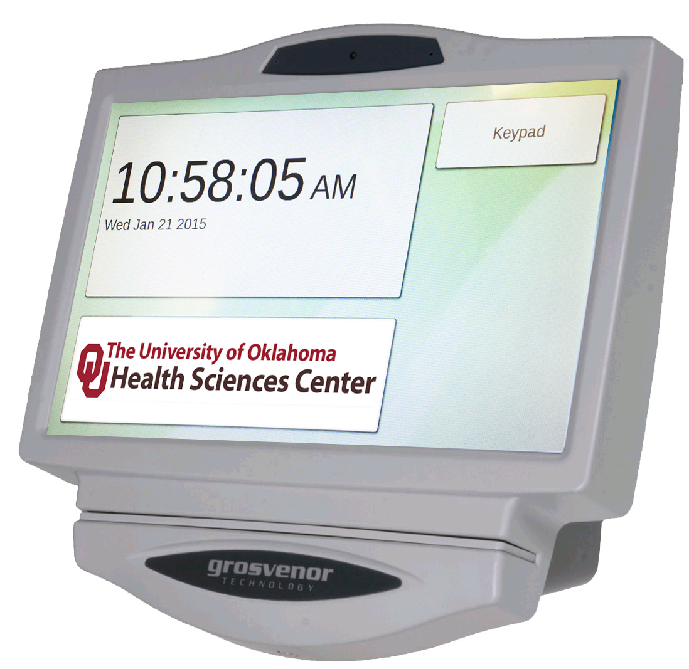
Time Clocks
Time clocks in buildings across campus
Uses OneCard
If an employee clocks in on a physical time clock, must clock out on a physical time clock
Keypad for HR# (EmplID)

Slide 29
Time Clock Screens

Slide 30
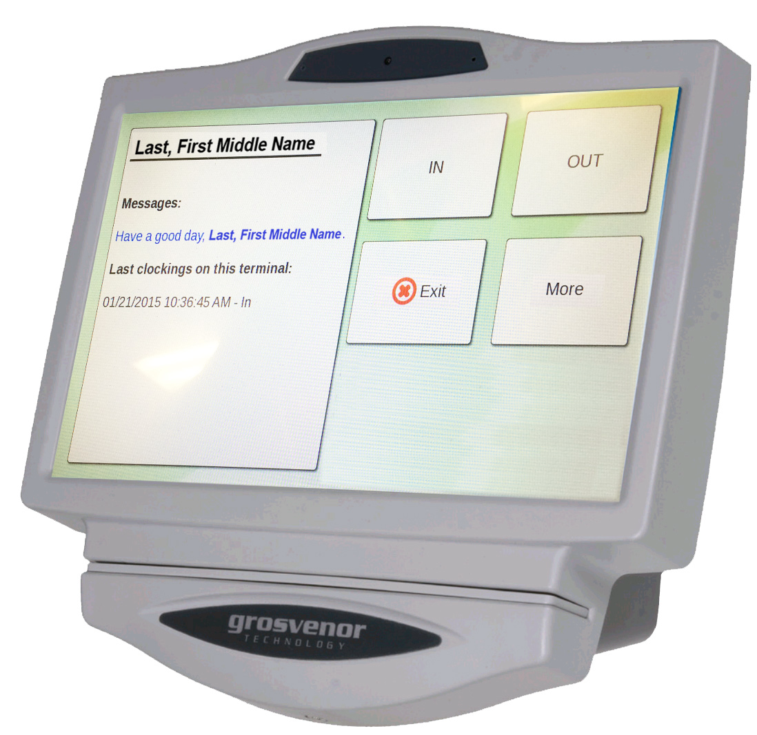
Time Clock Screens

Slide 31
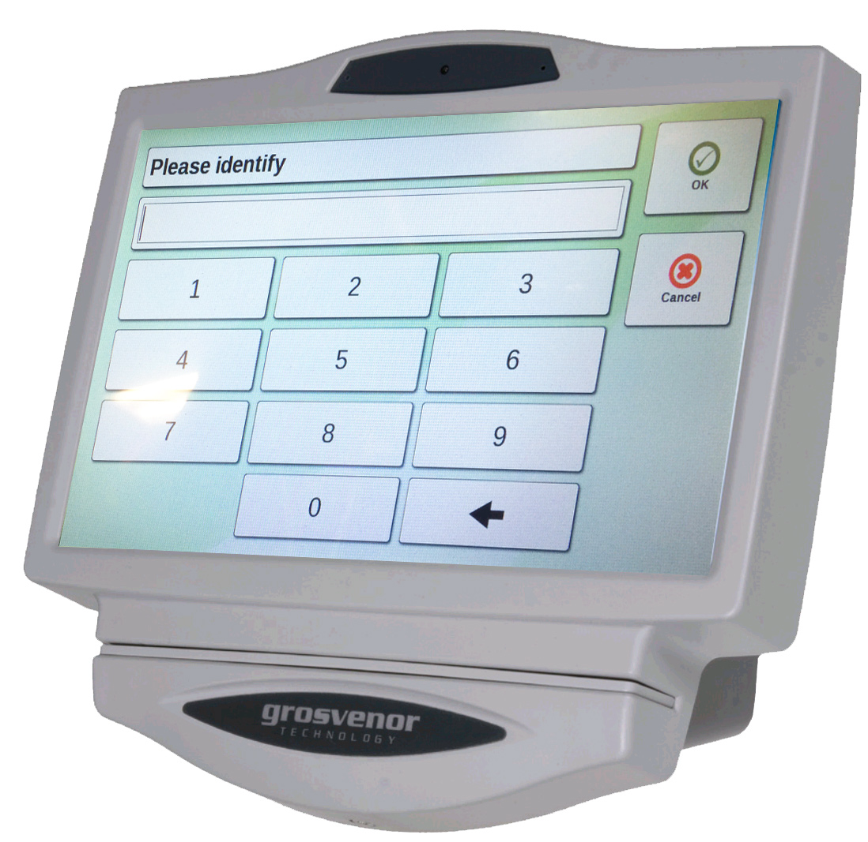
Time Clock Screens

Slide 32
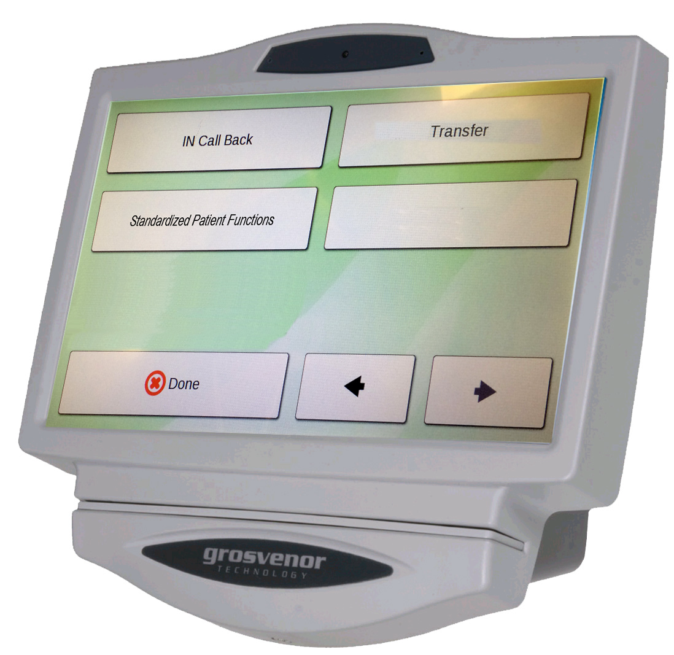
Time Clock Screens

Slide 33
Tracking Hours for ACA
ACA requires reporting hours for < .75 FTE
Options ranging from most effort/lowest cost to least effort/highest cost
Duration timesheet to track actual hours
Adjunct Professor/Graduate Assistant Safe Harbor formulas
Assume 8 hours for any day worked
Assume 40 hours for any week worked
Don’t track hours
Employee assumed to have full-time eligibility
Notes:
Direct questions to TAL-Questions@Ouhsc.edu, a mailbox that will be monitored by TAL Project Team members to ensure that questions are answered by subject matter experts in a timely manner.

Slide 34
Supervisors and Approvers
TAL must be configured for one supervisor per employee for time and leave approvals
Supervisors will be gathered with leave selection
Can delegate to others within system
New ePAFs will require this information
Notes:
Direct questions to TAL-Questions@Ouhsc.edu, a mailbox that will be monitored by TAL Project Team members to ensure that questions are answered by subject matter experts in a timely manner.

Slide 35
403(b) and 457(b) Timing
403(b): Changes made on the Fidelity website on or before the 3rd of the month will be deducted in the current month
457(b): Changes made on the Fidelity website on or before the 3rd of the month will be deducted beginning the 1st the following month
Year-end adjustments must be made on or before October 3rd
Information will be placed on HR web site

Slide 36
Training
Payroll coordinator hands on sessions in April
Supervisor instructor-led sessions late April early May
Employee instructor-led sessions in May
Manuals, Job Aid and video at tal.ouhsc.edu
Payroll coordinators will be blocked from TAL system until they attend training

Slide 37
New Features
Paycheck modeler
Will show monthly example until TAL, then biweekly
Electronic W4
State and Federal allowances must match
Extra withholdings can be different
Notes:
Direct questions to TAL-Questions@Ouhsc.edu, a mailbox that will be monitored by TAL Project Team members to ensure that questions are answered by subject matter experts in a timely manner.

Slide 38
Questions?
Lyndi Zavy, TAL Change Management Lead
Kevin Fitzgerald, Project Manager
TAL-Questions@ouhsc.edu
Notes:
Direct questions to TAL-Questions@Ouhsc.edu, a mailbox that will be monitored by TAL Project Team members to ensure that questions are answered by subject matter experts in a timely manner.

